Slide 1


Only Planner coded by Aima Ovbude https://github.com/ksu-is/OnlyPlanner
Only Planner will help people of various backgrounds organize their tasks according to urgency and importance levels. This way of organizing tasks is per the Eisen Hower matrix.

Slide 2
Reference Code

Slide 3
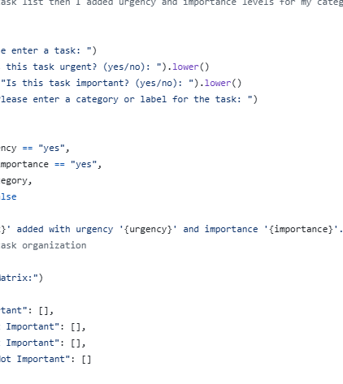
ONLY PLANNER CODE & features

Slide 5
Product benefits

Slide 7

Thank you

